Slide 1
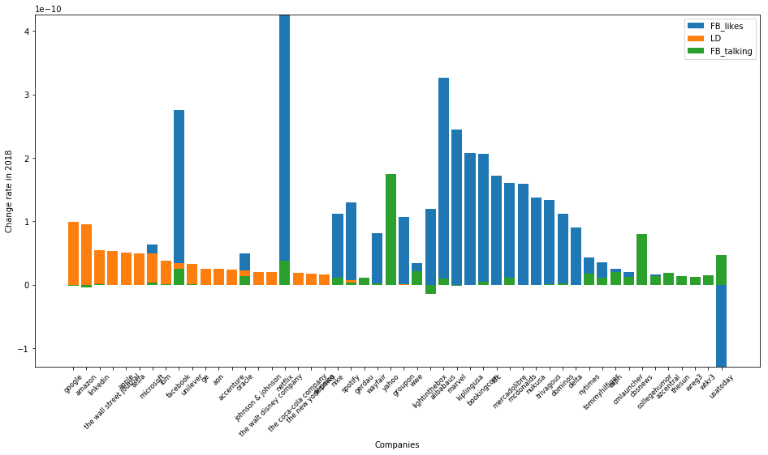
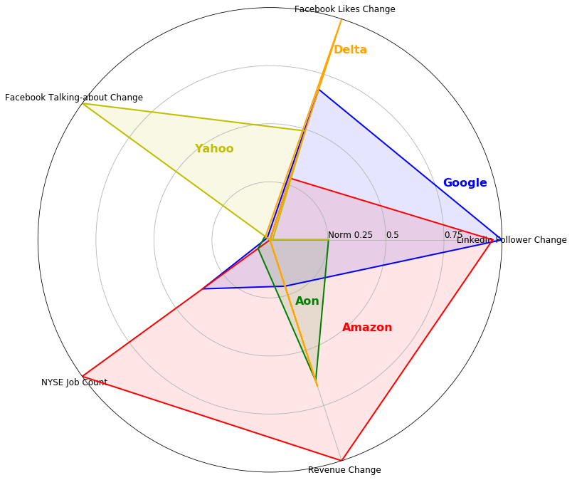
Social Media Activity of Companies Yunlong Zhang 08-13-2019
A. Change during 2018
B. Top 5 changed companies
C. Feature correlation
D. Visualization of instances
github.com/yunlong-zhang/The_data_incubator_capstone

Slide 2
SGD
SVC

